Slide 1
The 5 AM CLUB
Nakul Bajaj

Slide 2
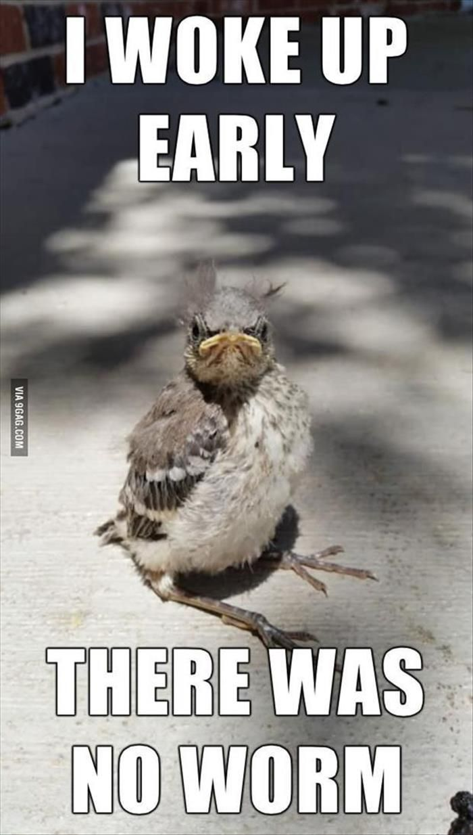
WHY 5 AM
Make some time for yourself
Why? Because I have so much to do, personal things taking least priority.
Why? Its necessary for my growth, but cannot balance it.
Why? Digital distractions, meetings, and work.
FOUND MY WHY !

Slide 3
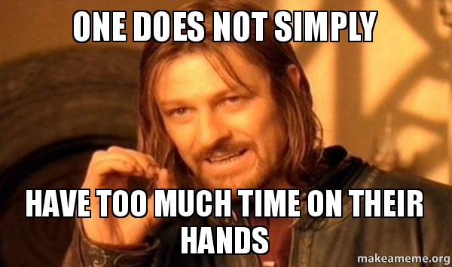
WHAT WOULD I DO FROM 5AM
Meditation
Making small notes in journal
Random workout (5-20) mins
Get into work, smash it out by midday
Did a Nanodegree over next 5 months

Slide 4
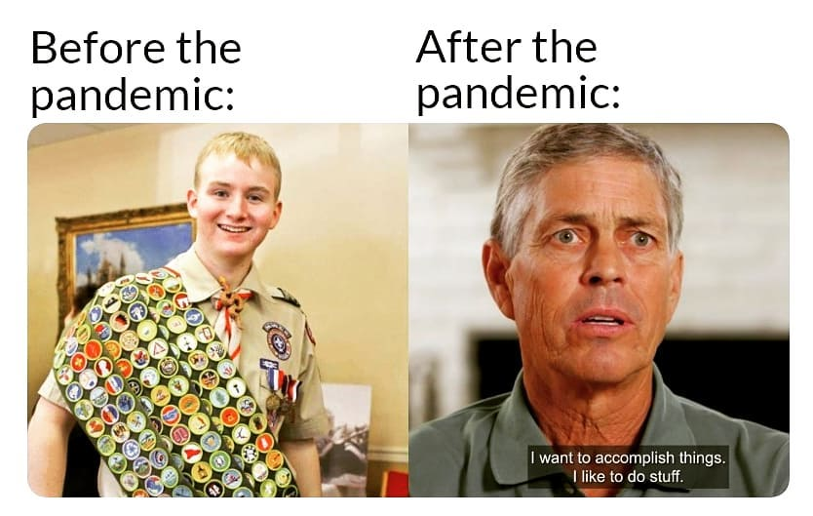
e to PowerPoint
BEFORE AND AFTER INCORPORATION
Before | After
Impulsive/Reactive | Bit Understanding/Caring
Constantly on the move | Better work life balance
No gratitude towards accomplishments | Enjoying a little, feeling happier where I am at
Exhausted of work, burnout, what is my purpose | Thinking how we could improve, what I could do better and what we as a team can do better
5 tips for a simpler way to work

Slide 5
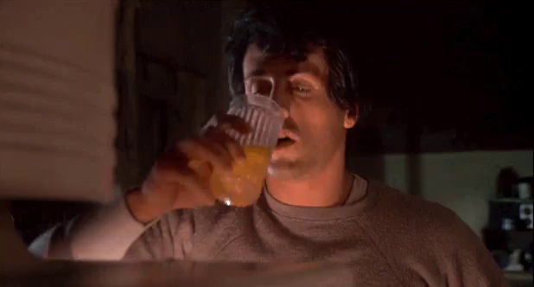
HOW TO WAKE UP EARLY
Open your lids and look at the wall, stretch around in bed
Wake up and dive into motivational videos
Read lot of news
Just get up out of bed as soon as you wake up
d. Just jump in that freezing water

Slide 6
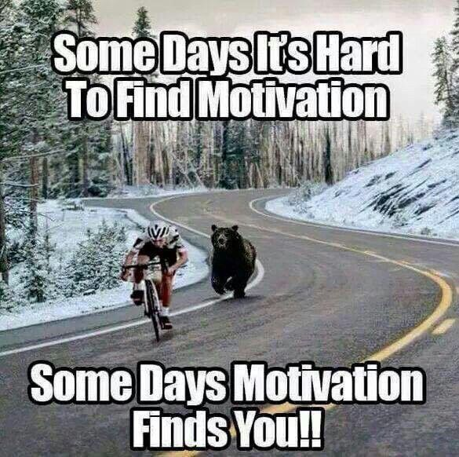
MINDSET IS NOT ENOUGH
Motivation videos will only take you as far

Slide 7
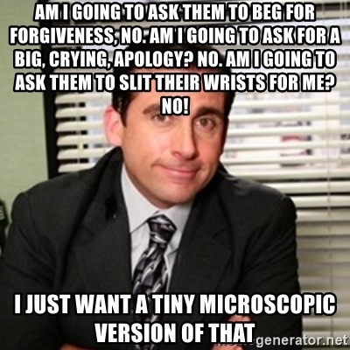
HEARTSET
No Repression
Forgiveness
Share feelings

Slide 8
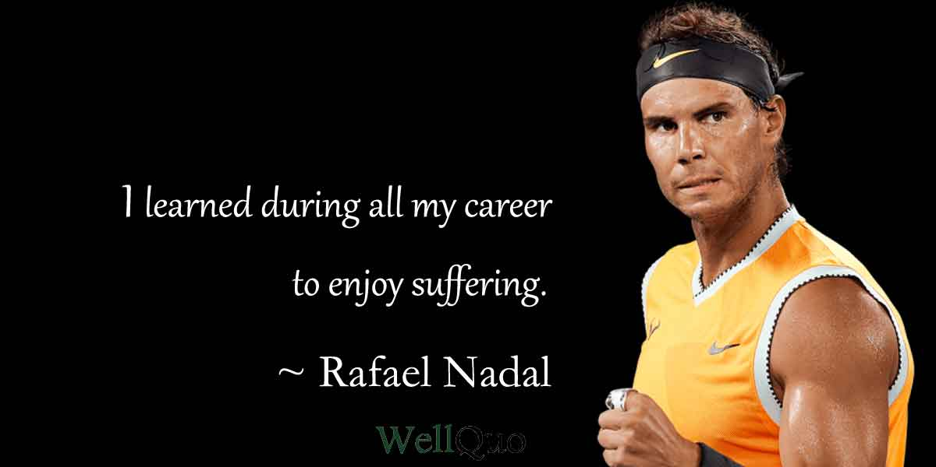
HEALTHSET
Excercise
Hygiene
You want those telomeres to hold on longer

Slide 9
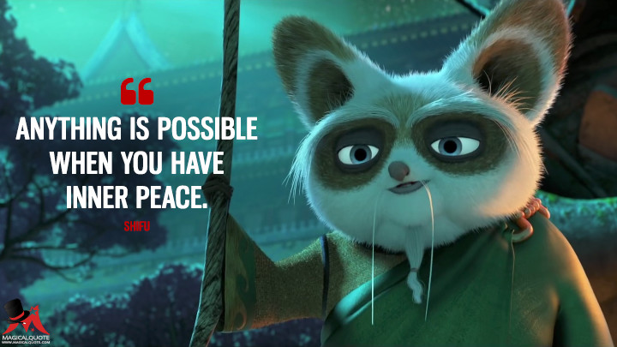
SOULSET
Time away from work
Solitude
Time in nature

Slide 10
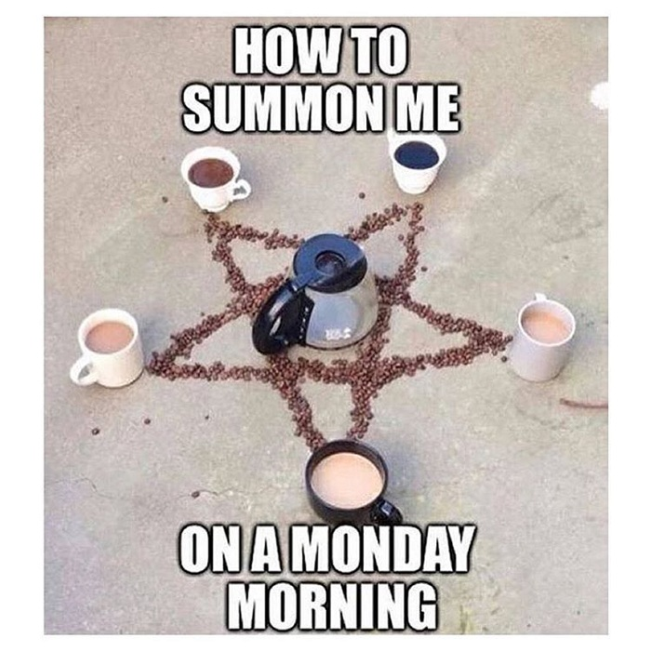
WHAT SHOULD I DO AT 5AM

Slide 11
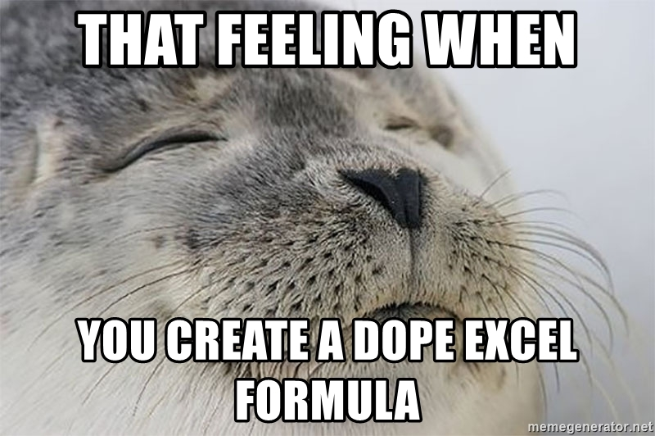
20 20 20 FORMULA
Exercise
Cortisol is highest in the morning
Regulate BDNF (Brain Derived Neurotrophic Factor) – Promotes neuroplasticity
Meditate/Solitude time in nature
Further reduces cortisol
Filling your soul
Learn something new
Knowledge is powerful
If you stay ignored, you will less likely to optimize

Slide 12

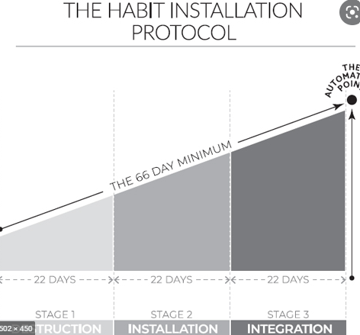
IS IT EASY, WILL IT WORK?
66 days
Combination of 20/20/20
Kryptonites of this method
Poor night routine
Late coffee or a big night
Tiredness

Slide 13

WHAT TO WATCH OUT FOR?
Your routine is not completely determined by you
Poor communication
Distractions are everywhere
Raji covered as part of “other focus” as part of her presentation

Slide 14
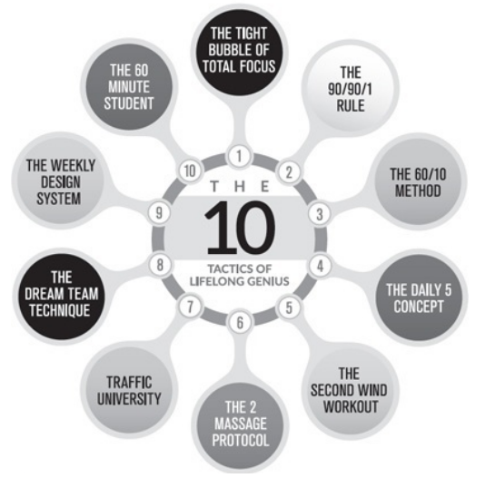
TO BECOME A TOTAL GENIUS
Suggest build one or two habits
Start with 20/20/20
Don’t forget to find your why
We all have bad moments, days of fear
Lets build an athletic brain

Slide 15

THANK YOU

